Slide 1

Notes:
Open by stating that this is a readiness briefing, not a project announcement.
[Sources]
- /Users/shawn/Desktop/EnergiAcres/EnergiAcres_Belmont_Barnesville_Data_Room_Research_Report_2026-08-24.docx

Slide 2
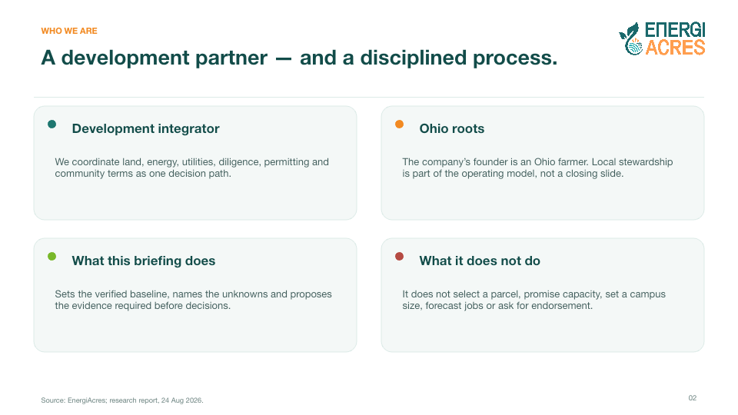
Notes:
Keep the distinction between developer role and decision authority explicit.
[Sources]
- /Users/shawn/Desktop/EnergiAcres/EnergiAcres_Belmont_Barnesville_Data_Room_Research_Report_2026-08-24.docx
- EnergiAcres Community Briefing Deck (source presentation supplied by user)

Slide 3
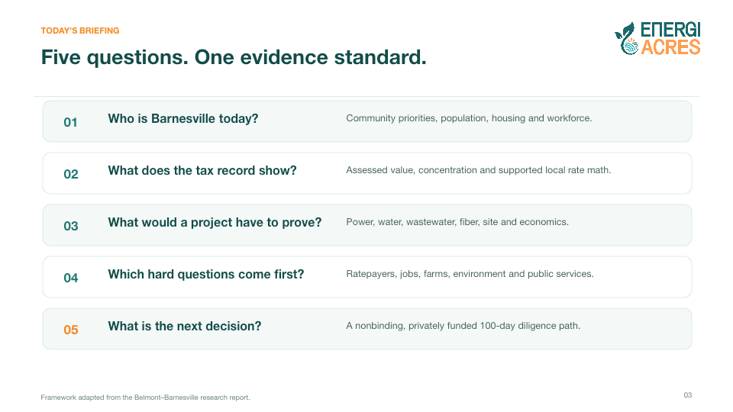
Notes:
Explain the facts-first sequence before discussing any project concept.
[Sources]
- /Users/shawn/Desktop/EnergiAcres/EnergiAcres_Belmont_Barnesville_Data_Room_Research_Report_2026-08-24.docx

Slide 4

Notes:
[Sources]
- /Users/shawn/Desktop/EnergiAcres/EnergiAcres_Belmont_Barnesville_Data_Room_Research_Report_2026-08-24.docx

Slide 5
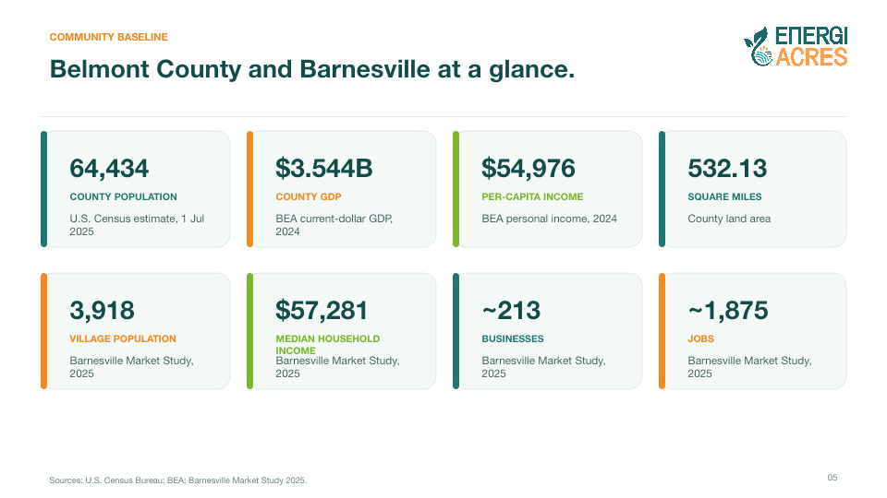
Notes:
[Sources]
- /Users/shawn/Desktop/EnergiAcres/EnergiAcres_Belmont_Barnesville_Data_Room_Research_Report_2026-08-24.docx
- https://www.census.gov/quickfacts/fact/table/belmontcountyohio/PST045225
- https://www.bea.gov/data/gdp/gdp-county-metro-and-other-areas
- Barnesville Market Study 2025 (local data-room source)

Slide 6
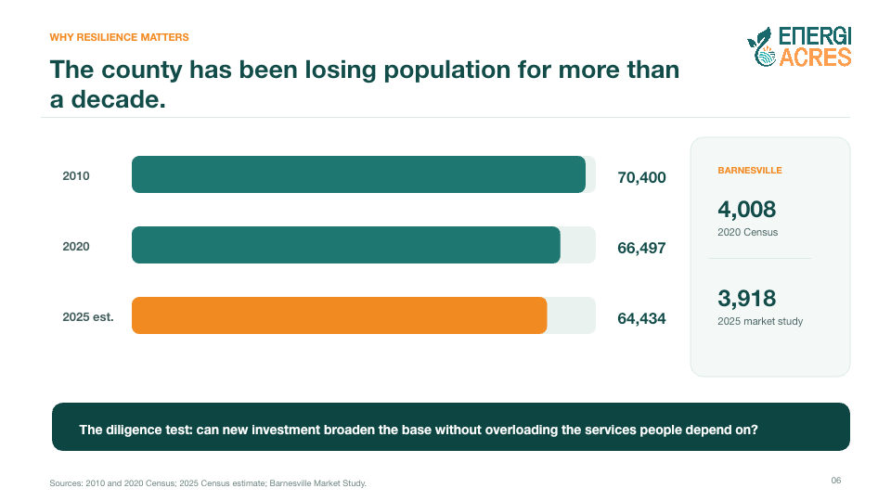
Notes:
[Sources]
- /Users/shawn/Desktop/EnergiAcres/EnergiAcres_Belmont_Barnesville_Data_Room_Research_Report_2026-08-24.docx
- https://www.census.gov/quickfacts/fact/table/belmontcountyohio/PST045225
- Barnesville Market Study 2025 (local data-room source)

Slide 7
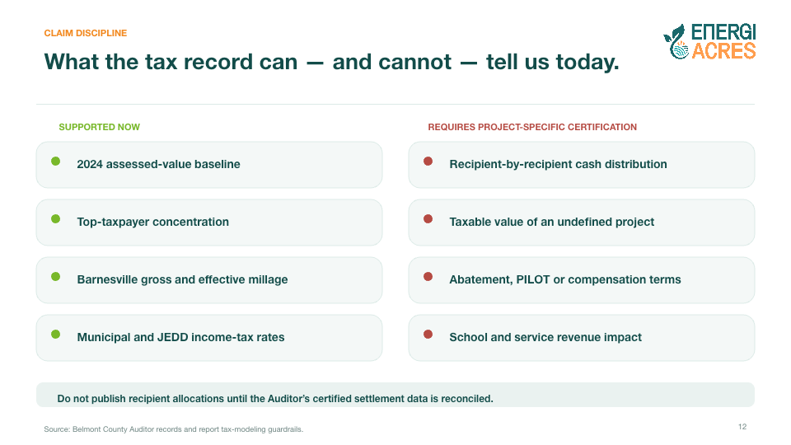
Notes:
The survey is directional community input, not a referendum or project approval.
[Sources]
- /Users/shawn/Desktop/EnergiAcres/EnergiAcres_Belmont_Barnesville_Data_Room_Research_Report_2026-08-24.docx
- Barnesville Community Survey 2025 graphic summary (local data-room source)

Slide 8
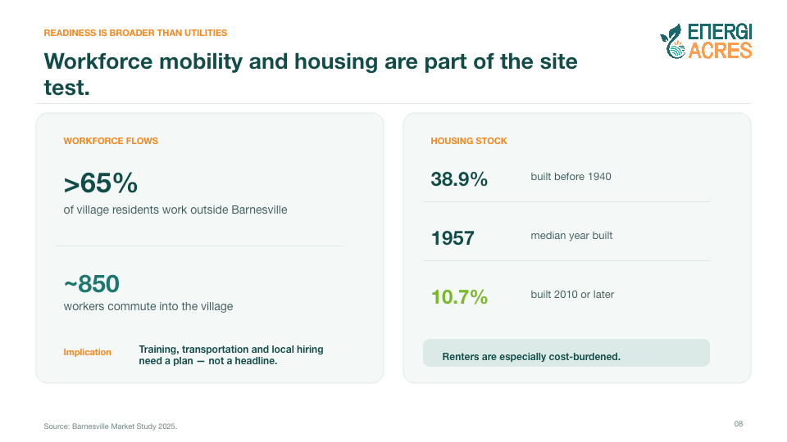
Notes:
[Sources]
- /Users/shawn/Desktop/EnergiAcres/EnergiAcres_Belmont_Barnesville_Data_Room_Research_Report_2026-08-24.docx
- Barnesville Market Study 2025 (local data-room source)

Slide 9

Notes:
[Sources]
- /Users/shawn/Desktop/EnergiAcres/EnergiAcres_Belmont_Barnesville_Data_Room_Research_Report_2026-08-24.docx

Slide 10
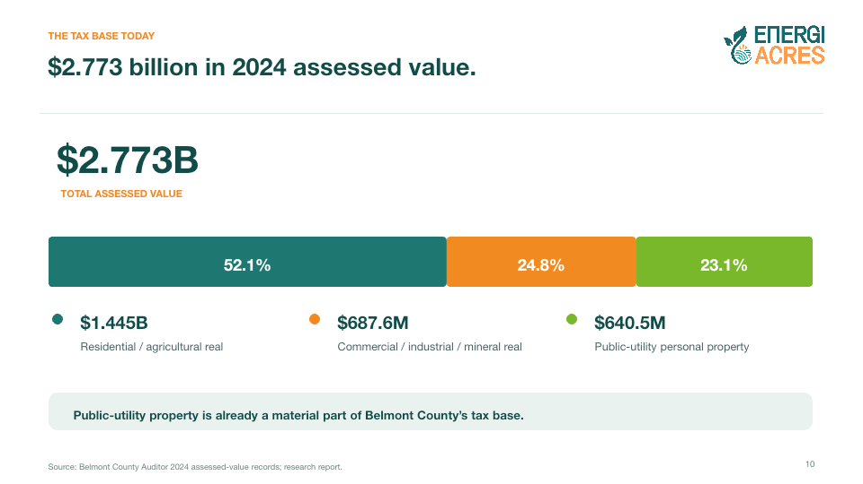
Notes:
[Sources]
- /Users/shawn/Desktop/EnergiAcres/EnergiAcres_Belmont_Barnesville_Data_Room_Research_Report_2026-08-24.docx
- Belmont County Auditor 2024 assessed-value records

Slide 11
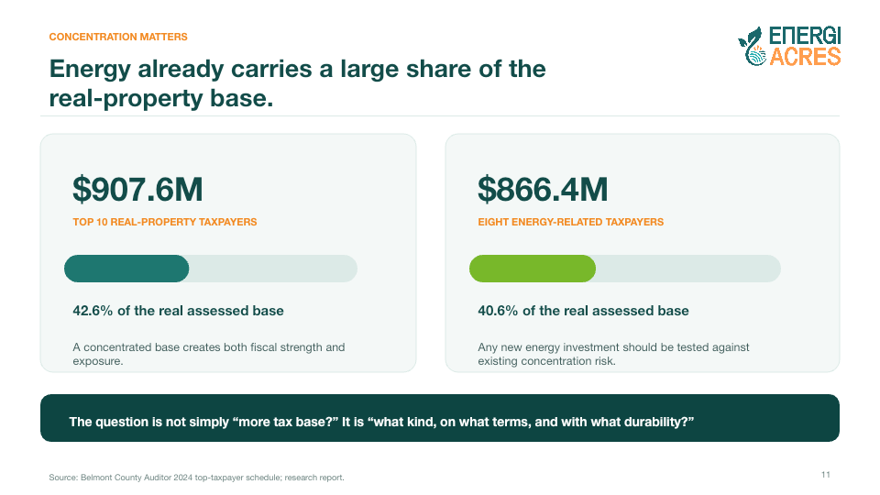
Notes:
[Sources]
- /Users/shawn/Desktop/EnergiAcres/EnergiAcres_Belmont_Barnesville_Data_Room_Research_Report_2026-08-24.docx
- Belmont County Auditor 2024 top-taxpayer schedule

Slide 12
Notes:
[Sources]
- /Users/shawn/Desktop/EnergiAcres/EnergiAcres_Belmont_Barnesville_Data_Room_Research_Report_2026-08-24.docx
- Belmont County Auditor records

Slide 13
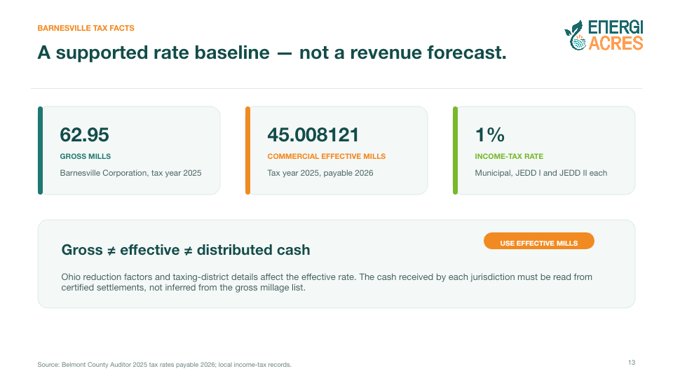
Notes:
[Sources]
- /Users/shawn/Desktop/EnergiAcres/EnergiAcres_Belmont_Barnesville_Data_Room_Research_Report_2026-08-24.docx
- Belmont County Auditor tax-rate schedule, tax year 2025 payable 2026

Slide 14
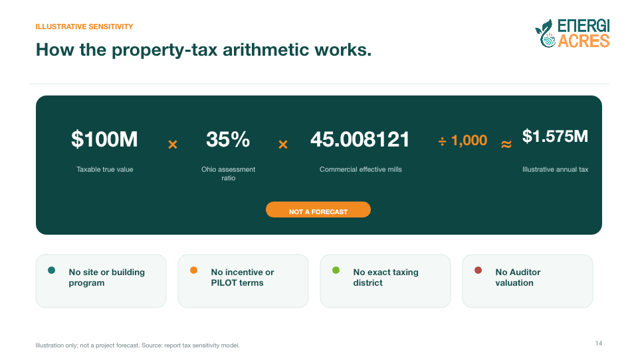
Notes:
Formula: true value × 35% assessment ratio × effective mills ÷ 1,000.
[Sources]
- /Users/shawn/Desktop/EnergiAcres/EnergiAcres_Belmont_Barnesville_Data_Room_Research_Report_2026-08-24.docx
- Belmont County Auditor commercial effective millage, tax year 2025 payable 2026

Slide 15

Notes:
[Sources]
- /Users/shawn/Desktop/EnergiAcres/EnergiAcres_Belmont_Barnesville_Data_Room_Research_Report_2026-08-24.docx

Slide 16
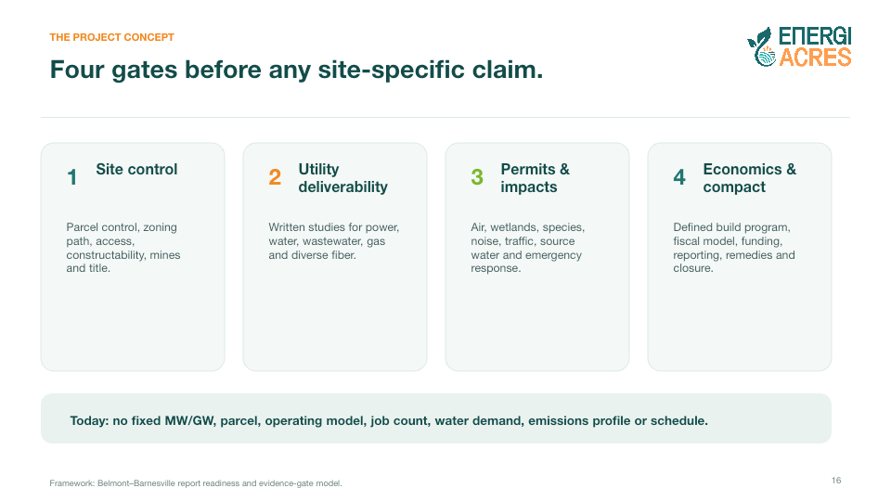
Notes:
[Sources]
- /Users/shawn/Desktop/EnergiAcres/EnergiAcres_Belmont_Barnesville_Data_Room_Research_Report_2026-08-24.docx

Slide 17
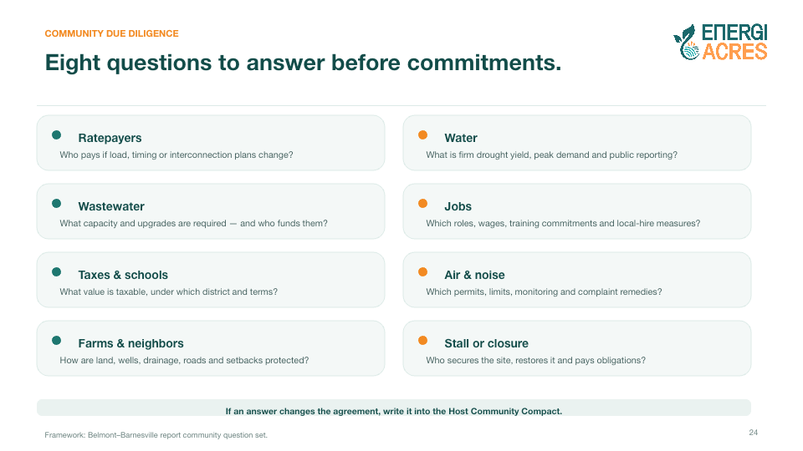
Notes:
The characterization of risk-shifting is an inference from the tariff structure, not a utility guarantee.
[Sources]
- /Users/shawn/Desktop/EnergiAcres/EnergiAcres_Belmont_Barnesville_Data_Room_Research_Report_2026-08-24.docx
- https://www.aepohio.com/company/about/rates/data-center-tariff

Slide 18
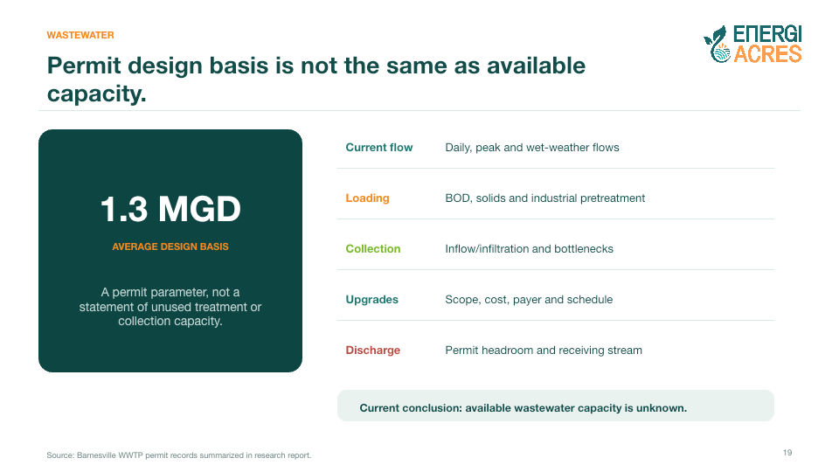
Notes:
[Sources]
- /Users/shawn/Desktop/EnergiAcres/EnergiAcres_Belmont_Barnesville_Data_Room_Research_Report_2026-08-24.docx
- Barnesville water-system records summarized in the report

Slide 19
Notes:
[Sources]
- /Users/shawn/Desktop/EnergiAcres/EnergiAcres_Belmont_Barnesville_Data_Room_Research_Report_2026-08-24.docx
- Barnesville WWTP permit records summarized in the report

Slide 20
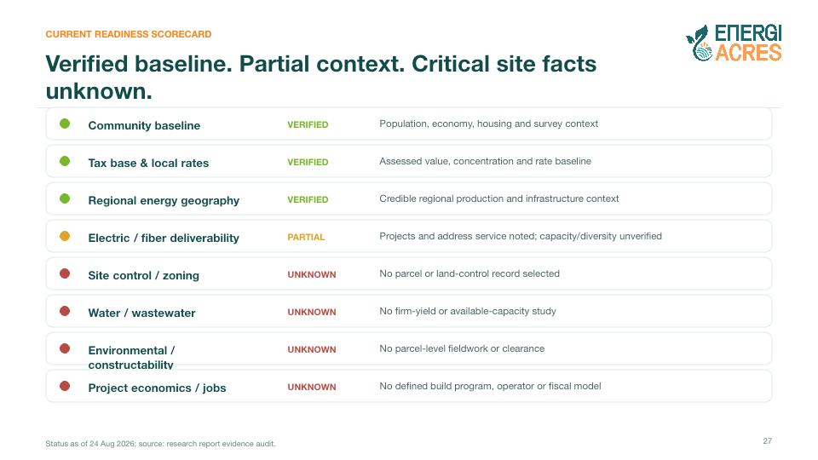
Notes:
[Sources]
- /Users/shawn/Desktop/EnergiAcres/EnergiAcres_Belmont_Barnesville_Data_Room_Research_Report_2026-08-24.docx
- https://www.aeptransmission.com/ohio/Barnesville/
- FAA airport data summarized in the report

Slide 21
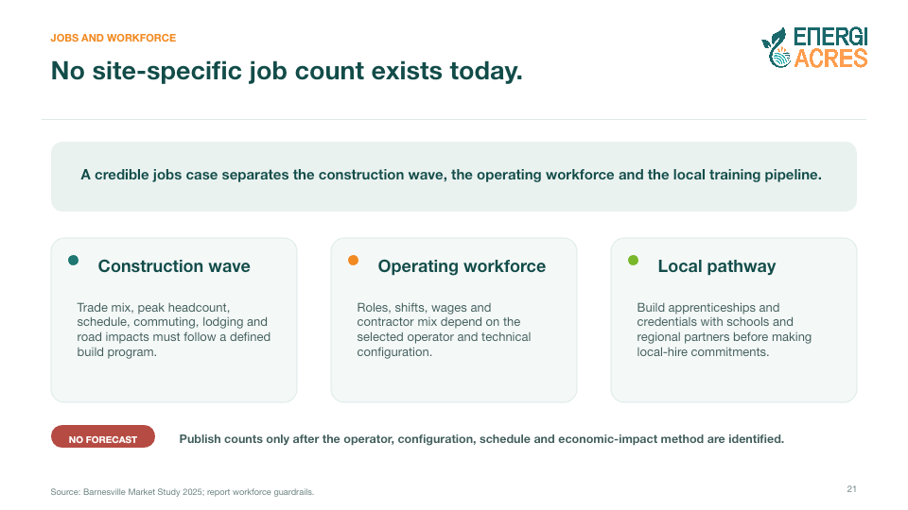
Notes:
[Sources]
- /Users/shawn/Desktop/EnergiAcres/EnergiAcres_Belmont_Barnesville_Data_Room_Research_Report_2026-08-24.docx
- Barnesville Market Study 2025 (local data-room source)

Slide 22
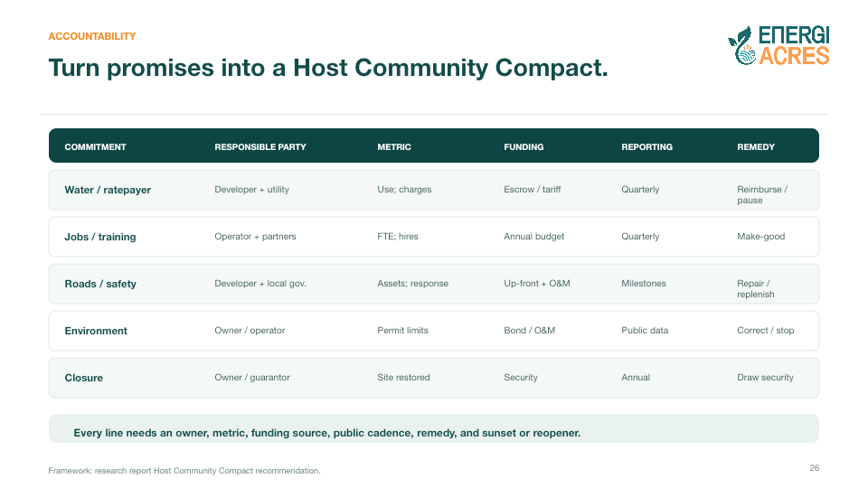
Notes:
[Sources]
- /Users/shawn/Desktop/EnergiAcres/EnergiAcres_Belmont_Barnesville_Data_Room_Research_Report_2026-08-24.docx

Slide 23

Notes:
[Sources]
- /Users/shawn/Desktop/EnergiAcres/EnergiAcres_Belmont_Barnesville_Data_Room_Research_Report_2026-08-24.docx

Slide 24
Notes:
[Sources]
- /Users/shawn/Desktop/EnergiAcres/EnergiAcres_Belmont_Barnesville_Data_Room_Research_Report_2026-08-24.docx

Slide 25
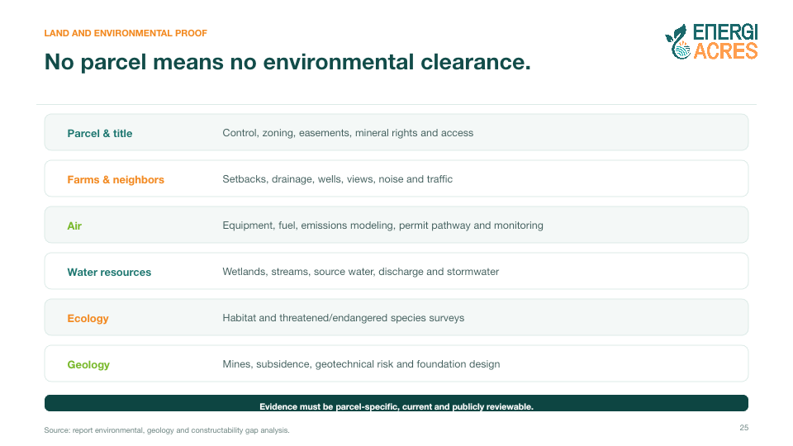
Notes:
[Sources]
- /Users/shawn/Desktop/EnergiAcres/EnergiAcres_Belmont_Barnesville_Data_Room_Research_Report_2026-08-24.docx

Slide 26
Notes:
This is a negotiating architecture, not a binding offer.
[Sources]
- /Users/shawn/Desktop/EnergiAcres/EnergiAcres_Belmont_Barnesville_Data_Room_Research_Report_2026-08-24.docx

Slide 27
Notes:
[Sources]
- /Users/shawn/Desktop/EnergiAcres/EnergiAcres_Belmont_Barnesville_Data_Room_Research_Report_2026-08-24.docx

Slide 28
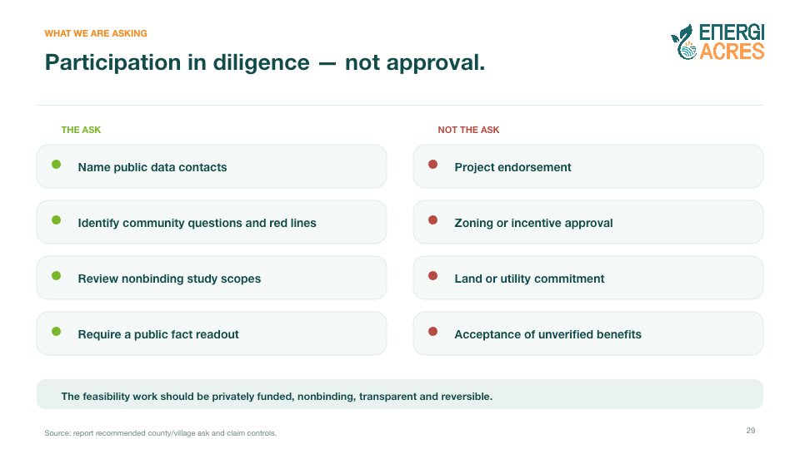
Notes:
[Sources]
- /Users/shawn/Desktop/EnergiAcres/EnergiAcres_Belmont_Barnesville_Data_Room_Research_Report_2026-08-24.docx

Slide 29
Notes:
[Sources]
- /Users/shawn/Desktop/EnergiAcres/EnergiAcres_Belmont_Barnesville_Data_Room_Research_Report_2026-08-24.docx

Slide 30

Notes:
[Sources]
- /Users/shawn/Desktop/EnergiAcres/EnergiAcres_Belmont_Barnesville_Data_Room_Research_Report_2026-08-24.docx

Slide 31
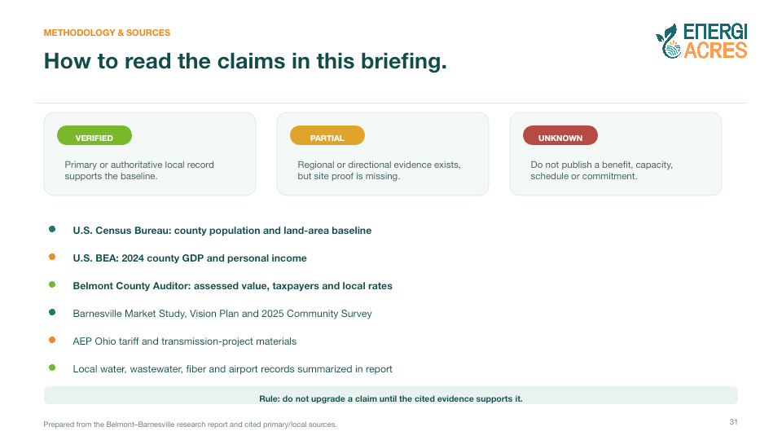
Notes:
[Sources]
- /Users/shawn/Desktop/EnergiAcres/EnergiAcres_Belmont_Barnesville_Data_Room_Research_Report_2026-08-24.docx
- https://www.census.gov/quickfacts/fact/table/belmontcountyohio/PST045225
- https://www.bea.gov/data/gdp/gdp-county-metro-and-other-areas
- Belmont County Auditor records cited in the report
- Barnesville Market Study, Vision Plan and Community Survey (local data-room sources)
- https://www.aepohio.com/company/about/rates/data-center-tariff

